Slide 1

Final Design Review - KSU 2
Electromechanical 3D Printed Prosthetic Arm Initiative
ME 575 - Interdisciplinary Industrial Design Projects II
Spring 2023
Section C
May 3, 2023
KSU 2:
Aydan Vanmeerhaeghe, Christopher Xu, Juan Ponce, Logan Senecal, Randen Plattner, and Vance Weber
Sponsor: Dr. Ronald Brockhoff
Faculty Advisor: Dr. B. Terry Beck
Notes:
R

Slide 2
Outline
Background Information
Project Overview
Prototype Design
Demonstration
Supporting Information
Conclusions
Notes:
J

Slide 3
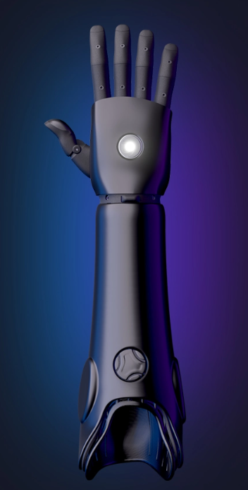

Background
Current market prosthetic arms are expensive and difficult to maintain
Notes:
C
[1]https://openbionics.com/hero-arm-overview/#:~:text=cutting%2Dedge%20features%E2%80%A6-,The%20Hero%20Arm%E2%84%A2%20is%20an%20advanced%2C%20lightweight%2C%203D%20printed,a%20below%2Delbow%20limb%20difference
[2] https://depositphotos.com/12800543/stock-illustration-money-bag-with-dollar-sign.html
C

Slide 4
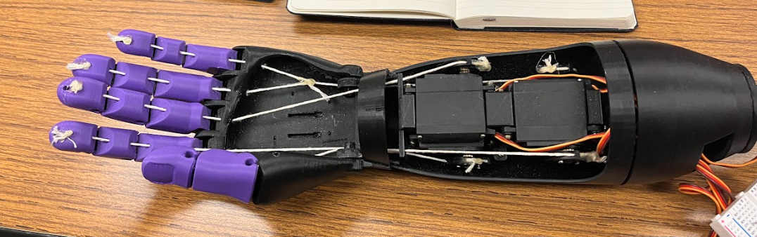
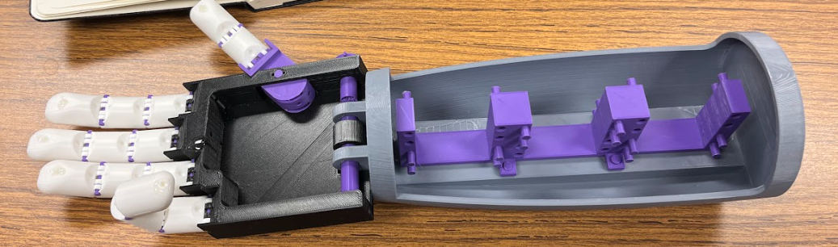
Background
Notes:
C

Slide 5
Project Statement
The project is targeted to individuals with limited resources and financial means to purchase a prosthetic device. This project involves creating a 3D-printed prosthetic arm and hand that can be constructed by the patient with limited technical expertise. Created parts must then be scalable for a variety of hand and arm sizes. The parts must then be controllable with simple pressure feedback.
Notes:
L

Slide 6
Deliverables
1. A complete model of the hand and forearm in SolidWorks.
2. A complete set of STL files for printing the hand and arm.
3. An assembled prototype of the hand and arm.
4. A supporting controller that allows the hand to be opened and closed.
5. Implementation of a feedback mechanism that allows the hand to grip both an egg without crushing it and a cue ball without dropping it.
6. Documentation for future development.
Notes:
V

Slide 7
Constraints / Specifications
1. The dimensions of the hand and arm must match that of Dr. Ronald Brockhoff.
2. The completed model must be scalable to different sizes.
3. All components must be easily purchasable.
4. Upon completion, all files must be uploaded to a public repository.
Notes:
A

Slide 8
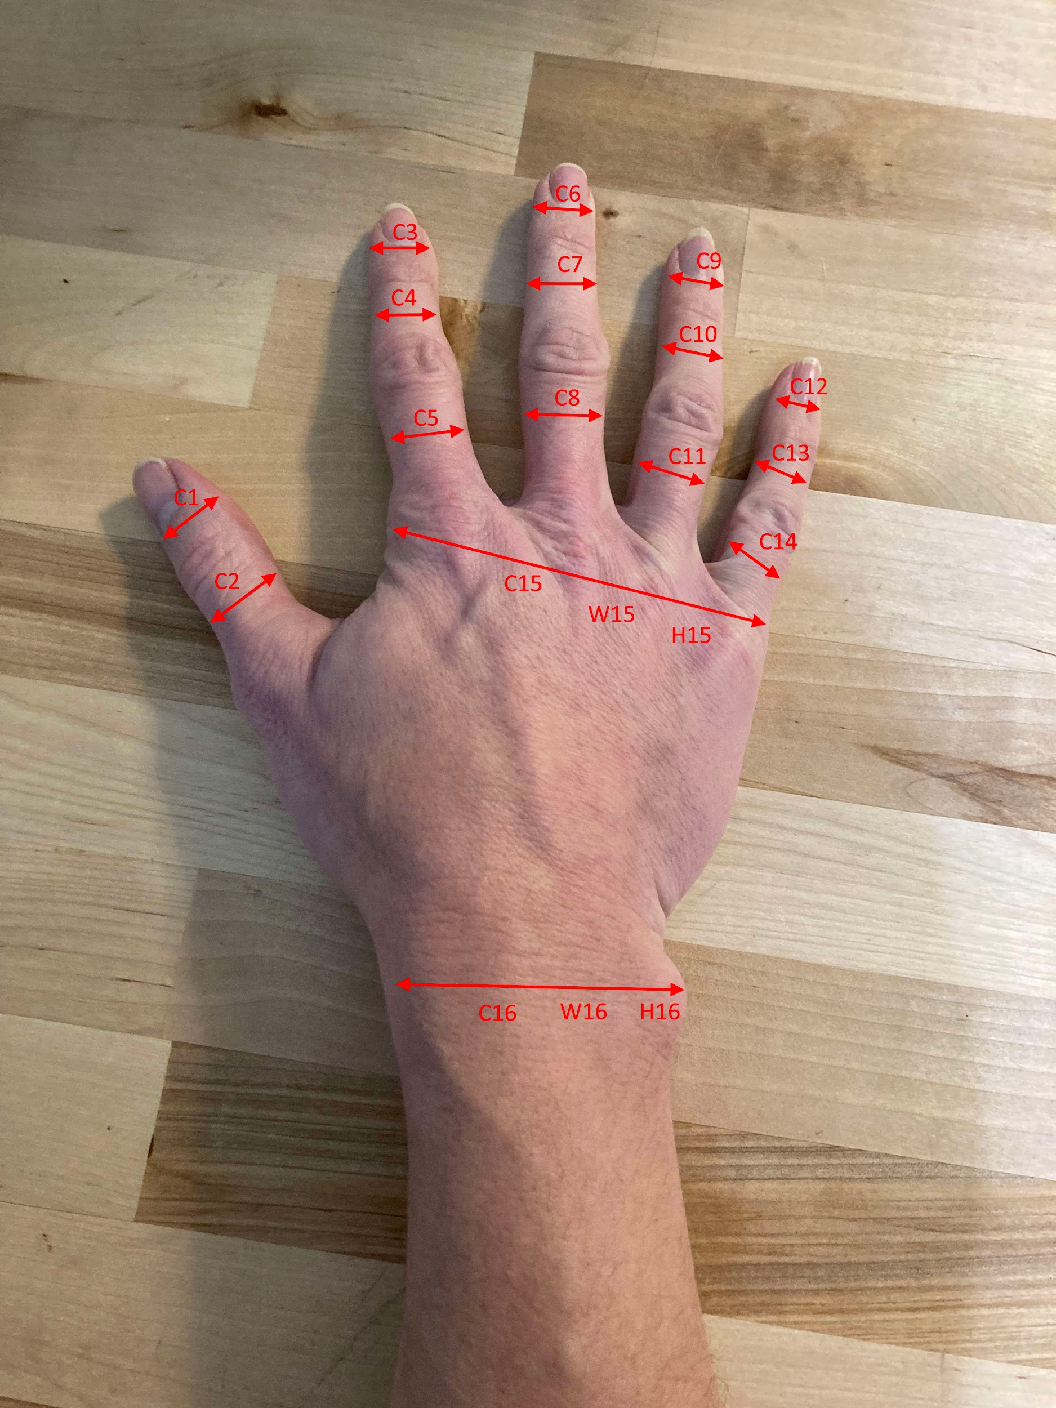
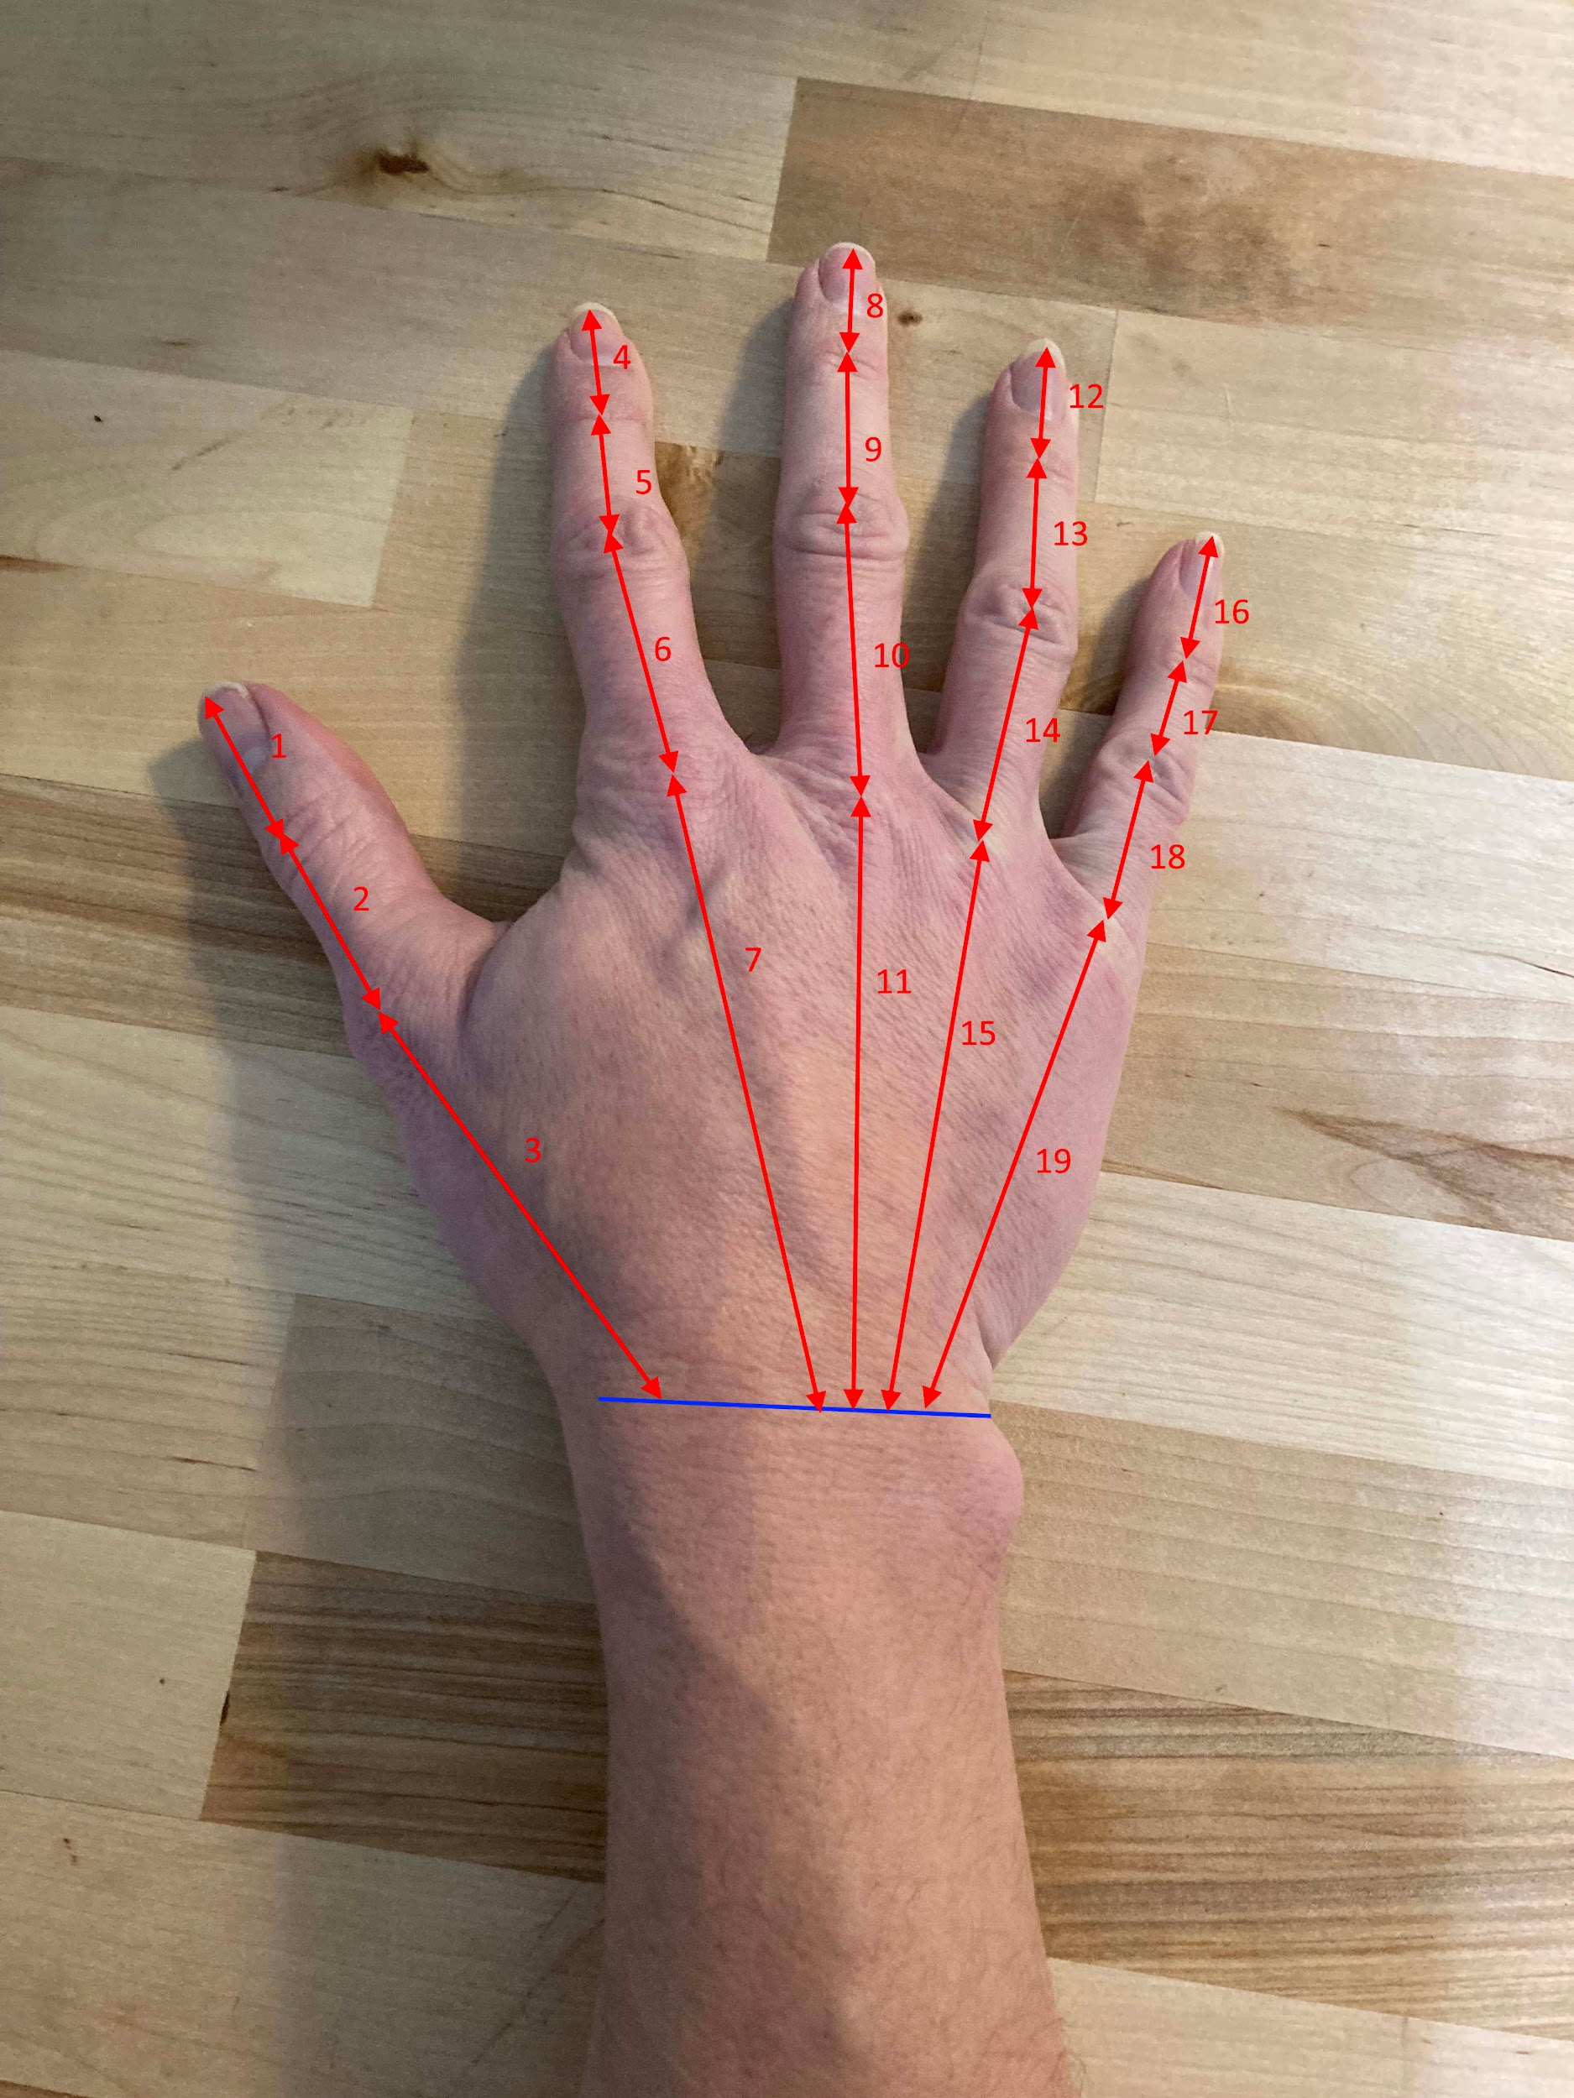
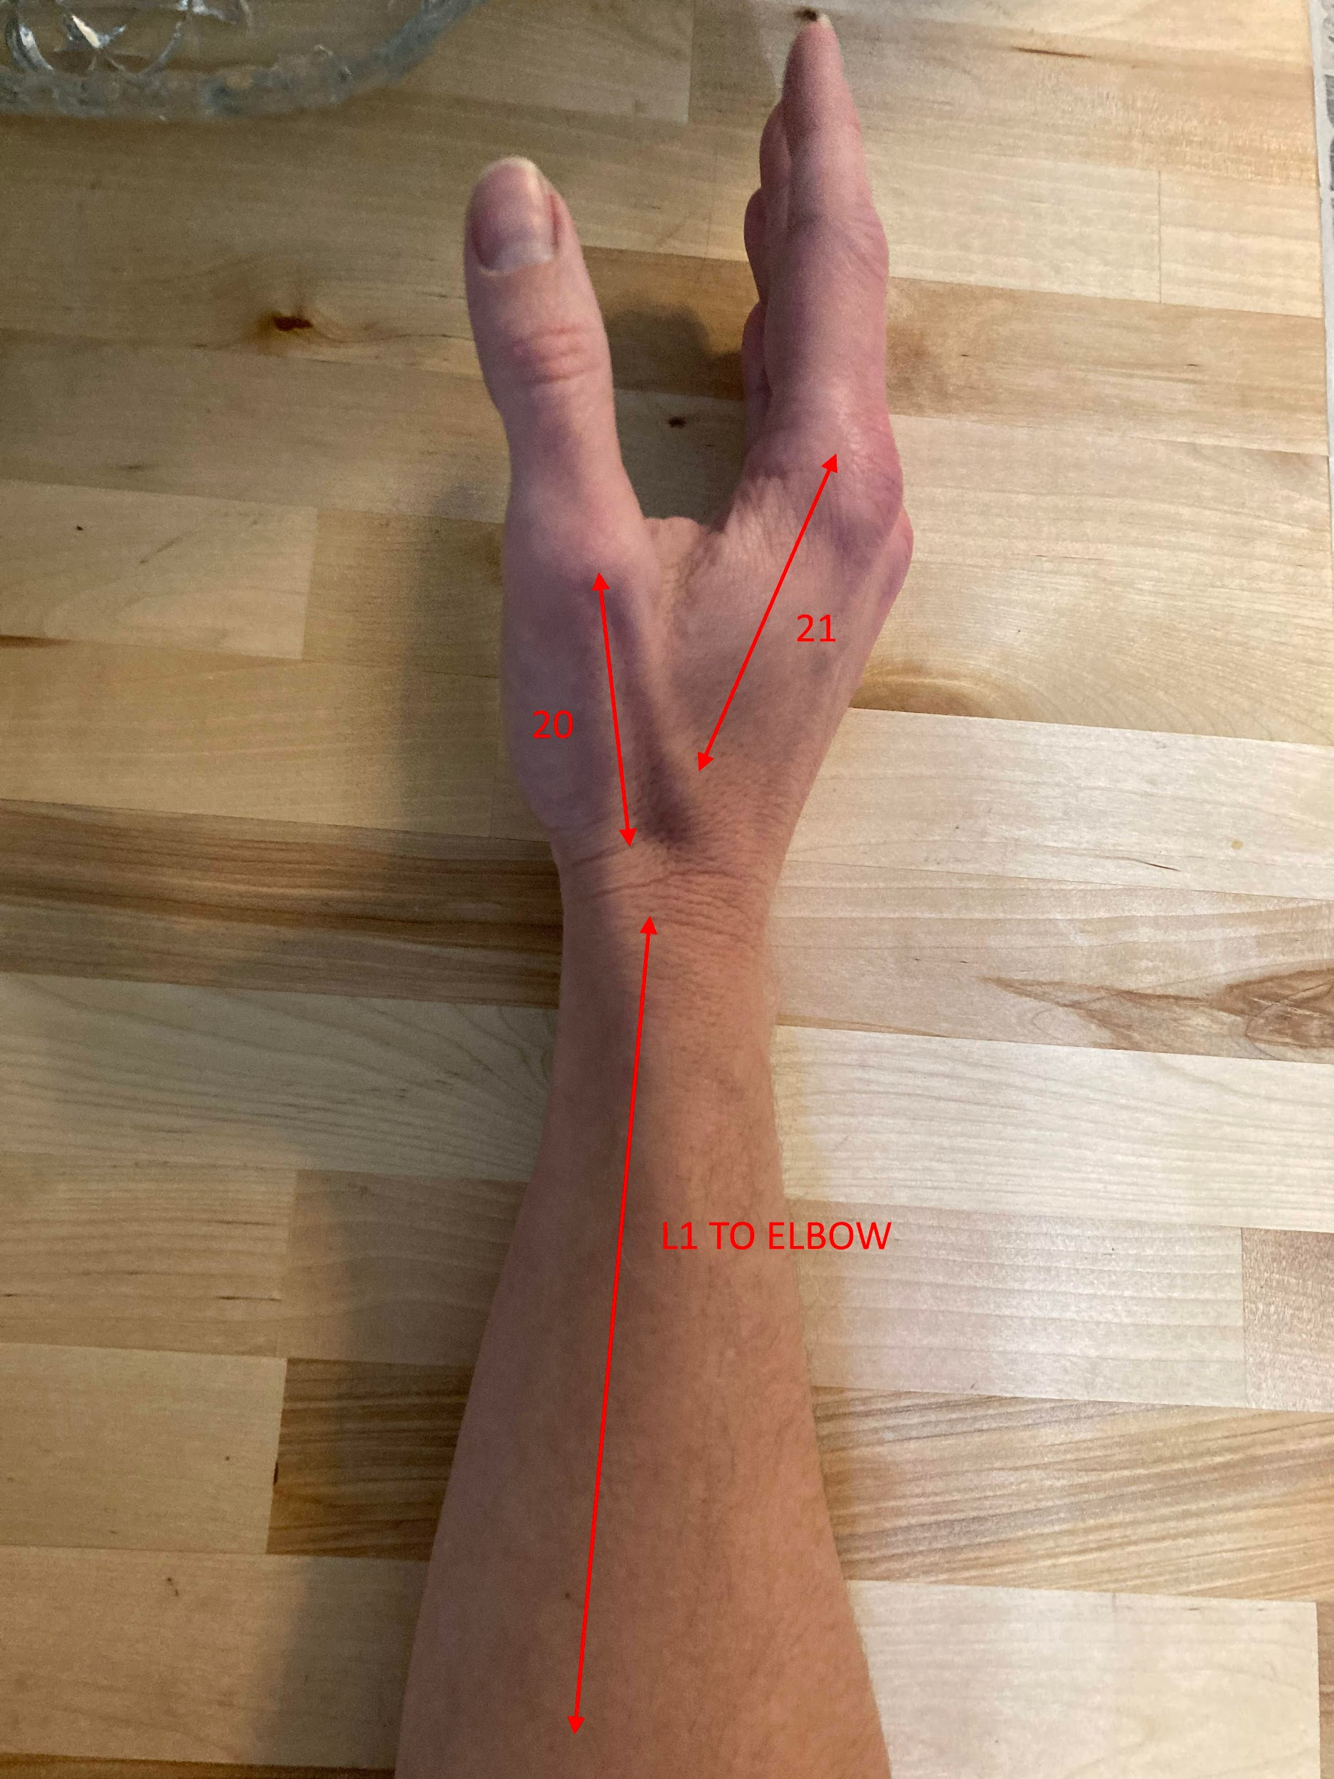
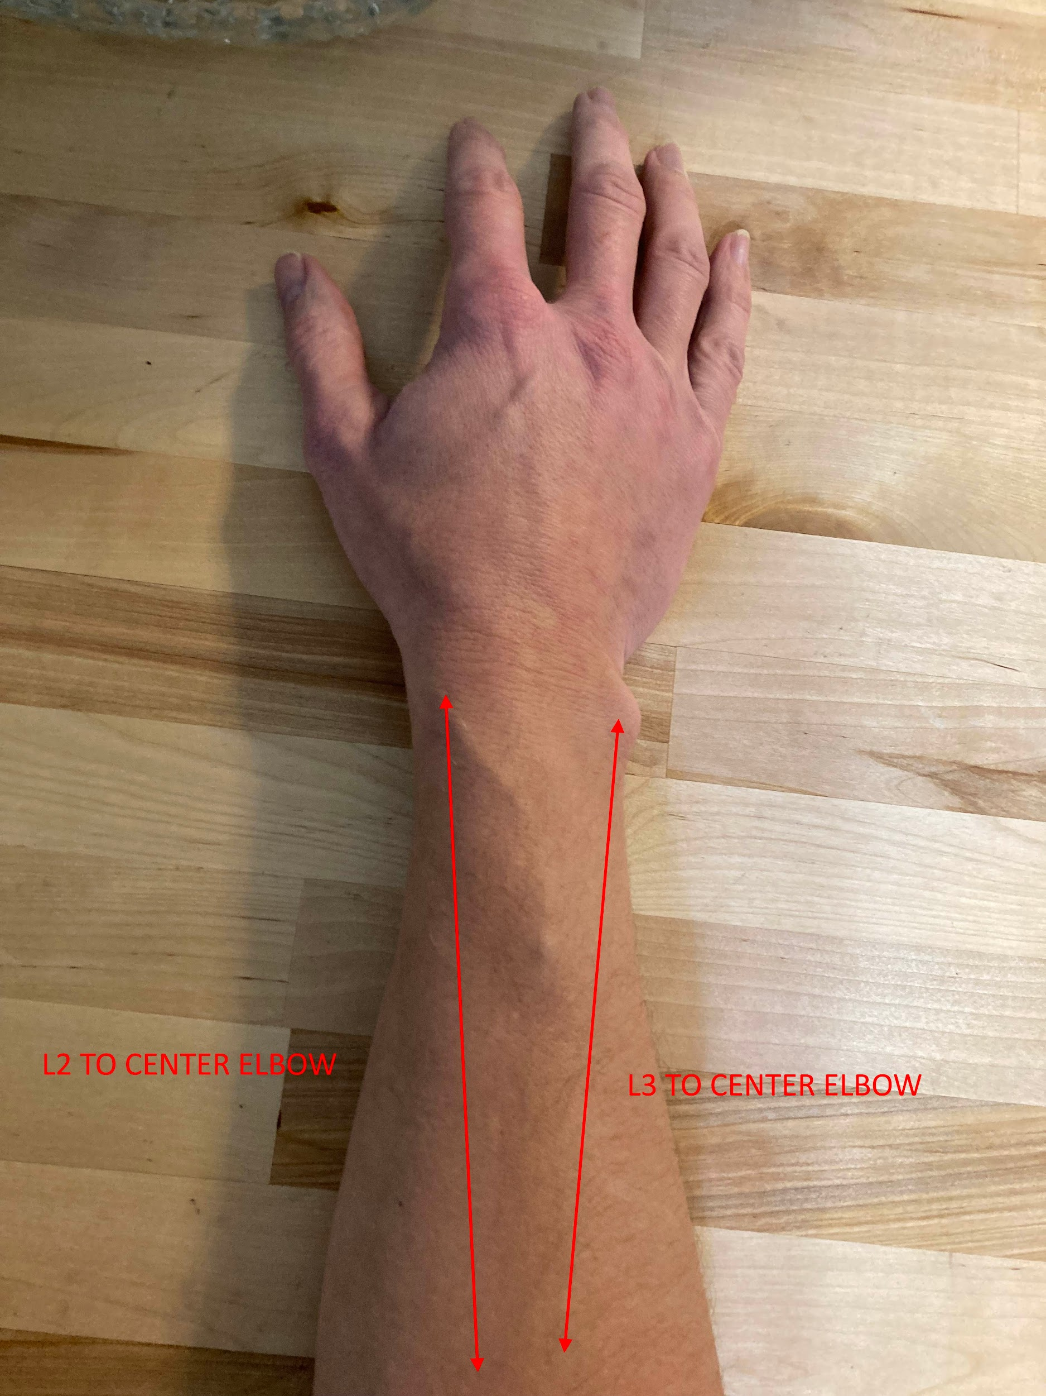
Dr. Brockhoff Hand Dimension

Slide 9
Dr. Brockhoff Hand Dimension
Reference Name From Images | Dimension [in.]
1 | 1.375
2 | 1.625
3 | 3.250
4 | 1.000
5 | 1.250
6 | 2.125
7 | 4.250
8 | 1.125
9 | 1.500
10 | 2.375
11 | 3.750
12 | 1.125
13 | 1.500
14 | 2.375
15 | 3.250
16 | 1.000
17 | 1.000
18 | 2.000
19 | 3.250
20 | 2.500
21 | 2.500
C1 | 2.125
Reference Name From Image | Dimension [in.]
C2 | 2.375
C3 | 1.875
C4 | 2.250
C5 | 2.750
C6 | 2.000
C7 | 2.250
C8 | 2.500
C9 | 1.625
C10 | 2.000
C11 | 2.500
C12 | 1.625
C13 | 1.750
C14 | 2.250
C15 | 8.500
C16 | 6.500
W15 | 3.750
W16 | 2.500
H15 | 1.000
H16 | 1.375
L1 | 11.000
L2 | 11.000
L3 | 10.500

Slide 10
Customer Identification
Due to the open-source nature of the product, the main customers are the direct consumers
Minimal need for marketing
Product must be compatible for individuals missing any part of their limb, with a residual limb up to their elbow region
Notes:
A

Slide 11
Quality Function Development (QFD)
Criteria of significant importance to the consumer were chosen to subjectively rank various arms
Three designs were compared to our final prototype by rating of 1, 3, or 5
Final prototype scored close to desired customer rank
All ratings are subjective and based on testing of product/information provided online
Notes:
A

Slide 12
QFD
Requirement | Kano Classification | Customer Desired Rank | KSU Repository Arm | KSU Undergrad Prototype | open bionics Hero Arm | Team 2 Prototype
Cost | basic | 5 (good) | 5 (good) | 5 (good) | 3 (acceptable) | 5 (good)
Reliability | basic | 5 (good) | 1 (poor) | 5 (good) | 5 (good) | 3 (acceptable)
Durability | performance | 3 (acceptable) | 1 (poor) | 5 (good) | 5 (good) | 3 (acceptable)
Strength | performance | 3 (acceptable) | 1 (poor) | 3 (acceptable) | 5 (good) | 1 (poor)
Scalability | performance | 3 (acceptable) | 1 (poor) | 1 (poor) | 5 (good) | 3 (acceptable)
Weight | performance | 5 (good) | 3 (acceptable) | 3 (acceptable) | 5 (good) | 5 (good)
Wrist Articulation (Up and Down) | basic | 5 (good) | 1 (poor) | 1 (poor) | 3 (acceptable) | 5 (good)
Wrist Articulation (Side to Side) | performance | 1 (poor) | 1 (poor) | 1 (poor) | 1 (poor) | 1 (poor)
Wrist Articulation (Rotational) | basic | 5 (good) | 1 (poor) | 1 (poor) | 5 (good) | 5 (good)
Ease of Assembly | basic | 5 (good) | 1 (poor) | 3 (acceptable) | 5 (good) | 3 (acceptable)

Slide 13
QFD
Requirement | Kano Classification | Customer Desired Rank | KSU Repository Arm | KSU Undergrad Prototype | open bionics Hero Arm | Team 2 Prototype
Number of Pieces to Assemble | performance | 3 (acceptable) | 5 (good) | 5 (good) | 5 (good) | 1 (poor)
Ease of Repair | basic | 5 (good) | 5 (good) | 3 (acceptable) | 1 (poor) | 3 (acceptable)
Rechargeable Batteries | performance | 3 (acceptable) | 1 (poor) | 1 (poor) | 5 (good) | 5 (good)
Aesthetics (Resemblance) | excitement | 3 (acceptable) | 1 (poor) | 5 (good) | 5 (good) | 3 (acceptable)
Noise Above Ambient | excitement | 1 (poor) | 3 (acceptable) | 3 (acceptable) | 5 (good) | 3 (acceptable)
Pressure Sensing | performance | 5 (good) | 1 (poor) | 1 (poor) | 5 (good) | 3 (acceptable)
Effect of Materials on Consumer | basic | 5 (good) | 5 (good) | 5 (good) | 5 (good) | 5 (good)
Effect of Materials on Environment | basic | 3 (acceptable) | 3 (acceptable) | 3 (acceptable) | 3 (acceptable) | 3 (acceptable)
Waterproof | excitement | 1 (poor) | 1 (poor) | 1 (poor) | 1 (poor) | 1 (poor)
Totals |  | 69 | 45 | 55 | 77 | 61

Slide 14
Prototype Design

Slide 15
Function of Product
The product should allow the customer to:
bend elbow
rotate wrist around two axis
contract fingers to make a fist
release fingers back to a flat hand
Notes:
L

Slide 16
Form of Product
The arm consists of:
5 fingers contracted by servos
Palm with housing for finger servos
Pressure sensor mounted to palm lid
Wrist with two servos
Forearm with housing for electronics
Notes:
L

Slide 17
Assumptions in Design Process
Consumer will have access to computer
The person needing the arm won’t be assembling it
Access to 3D printer
Experience with CAD and coding if design needs to change

Slide 18
Material Selection
Used PLA and PETG for prototyping
TPU used for grip on the fingertips and pressure sensor cover
Final arm is completely printed in PETG

Slide 19
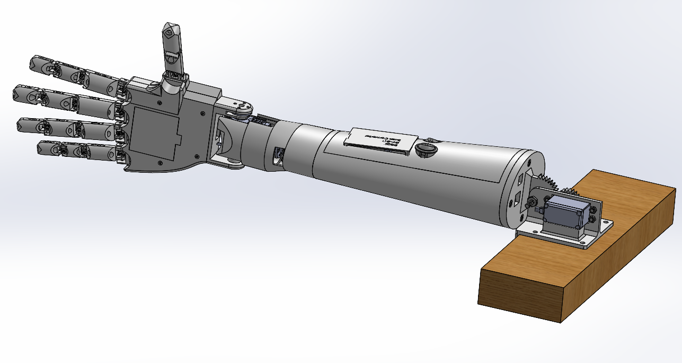
Design Breakdown
6 Subcategories
Fingers and Joints
Palm
Wrist
Forearm and Elbow
Electronics and Coding
Scalability
Notes:
R

Slide 20
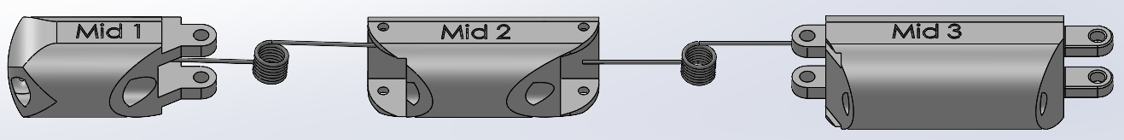
Fingers and Joints
• Torsion spring joints for flexibility and spring back
• Spider wire on front side of fingers
Finger tip
Finger base
Notes:
R

Slide 21
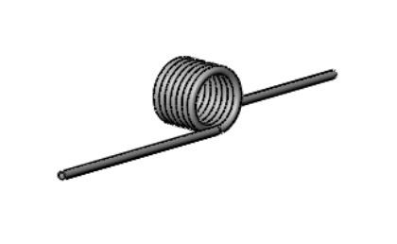
Torsion Spring Selection
Deflection angle
Outside diameter
Leg length
Torque
Notes:
180 deflection angle; OD of 0.224”; Leg length = 0.75”; Max torque of 0.402 in-lbs; (9271K94)
https://www.mcmaster.com/products/torsion-springs/deflection-angle~180-/

Slide 22
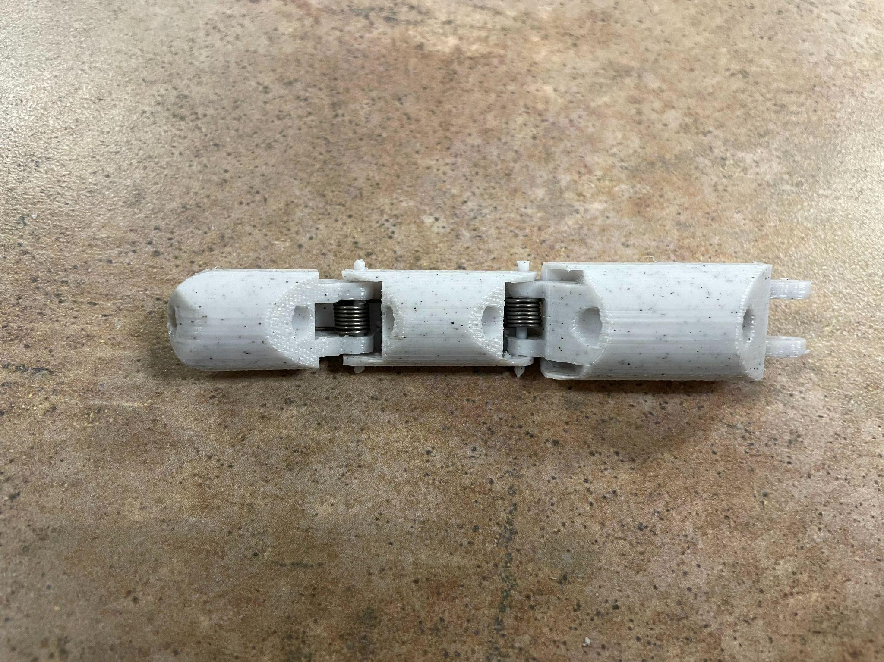
Fingers and Joints
Notes:
R

Slide 23
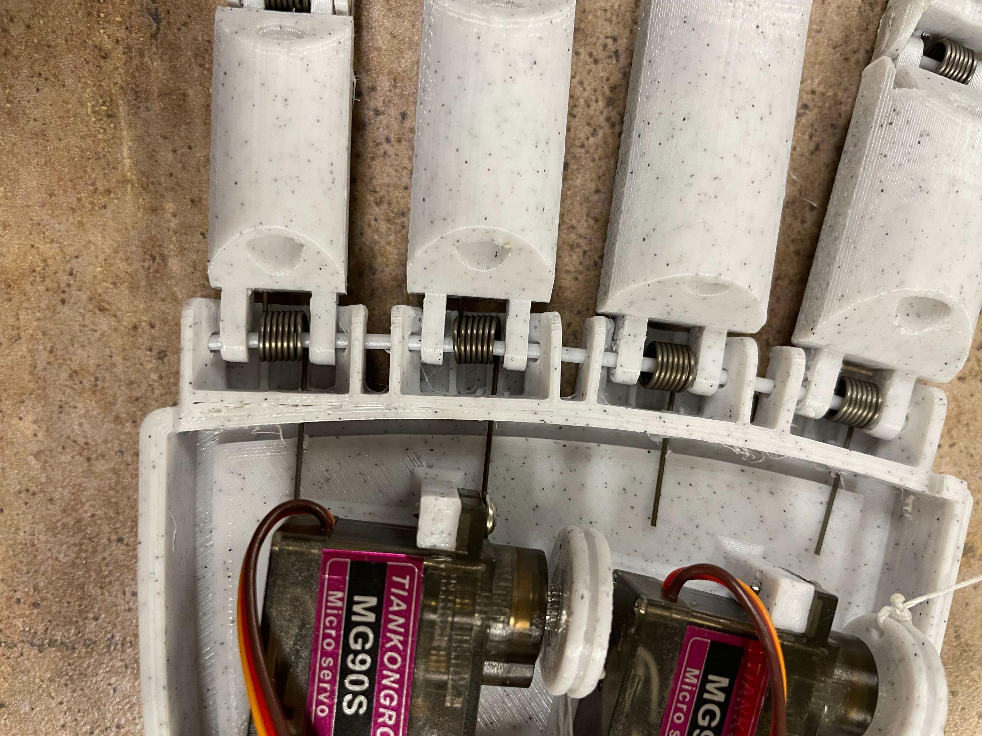
Connection to Palm

Slide 24
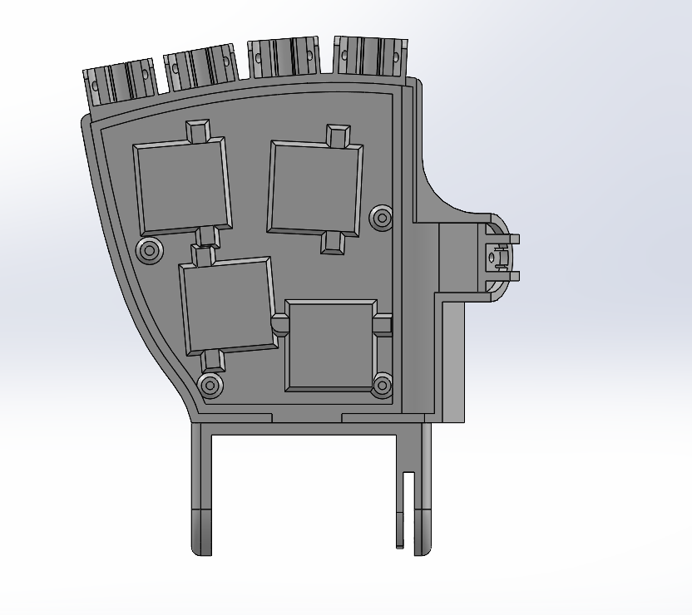
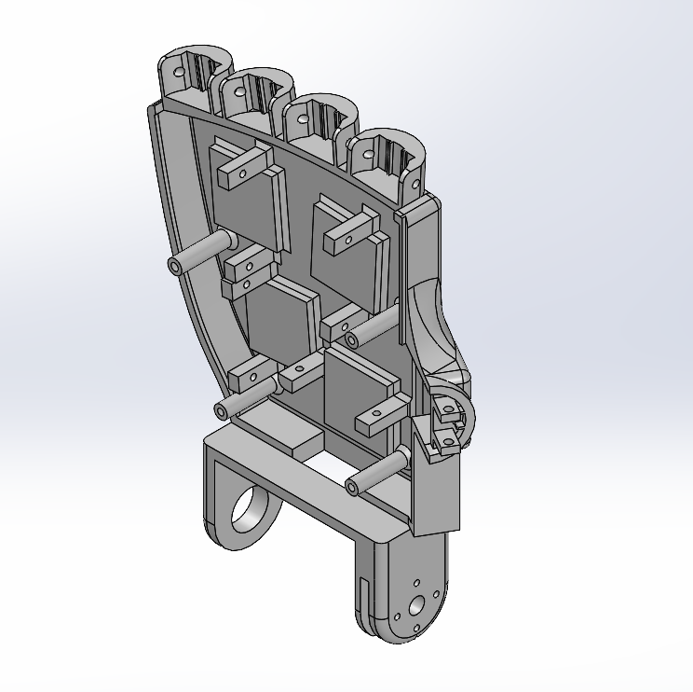

Slide 25
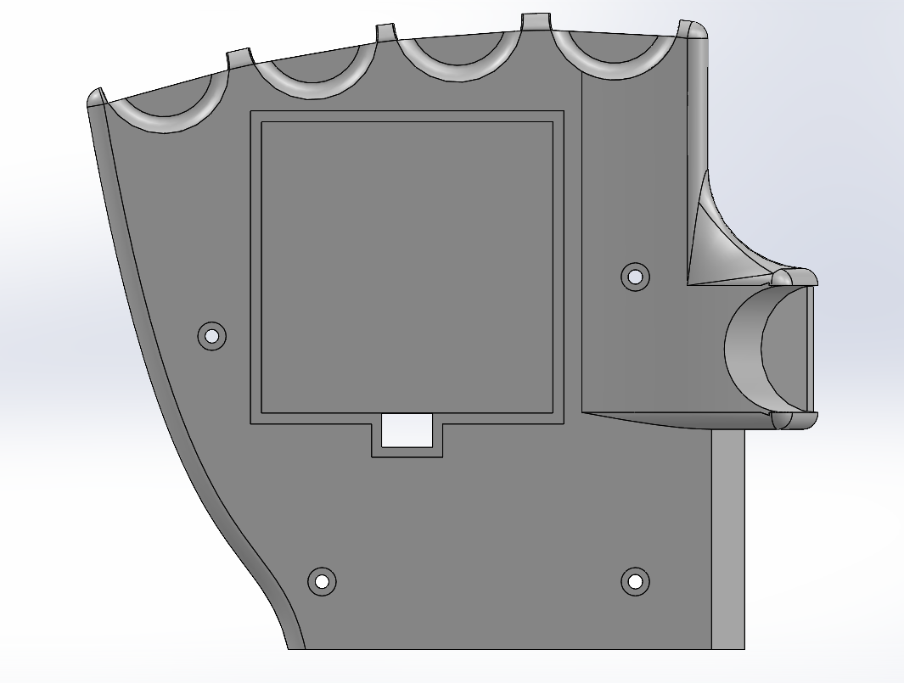
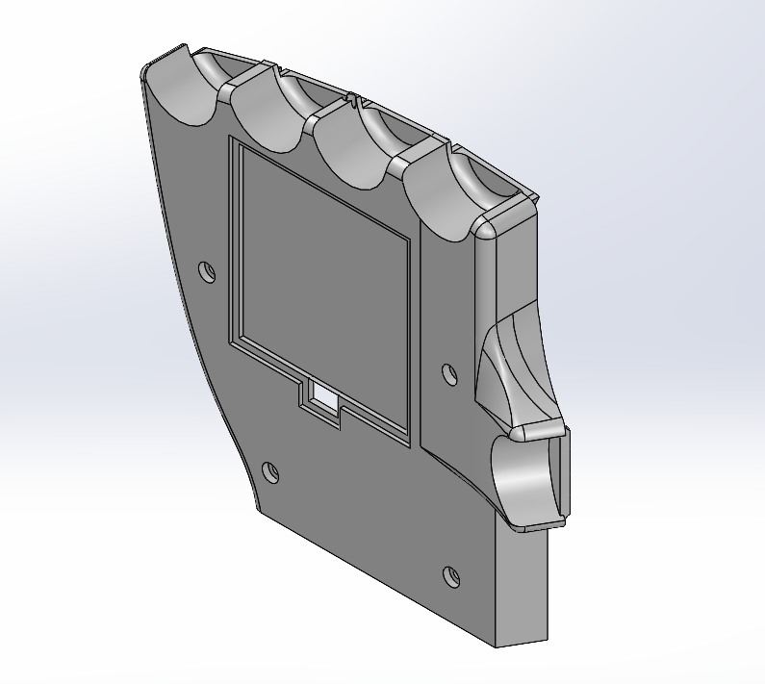

Slide 26
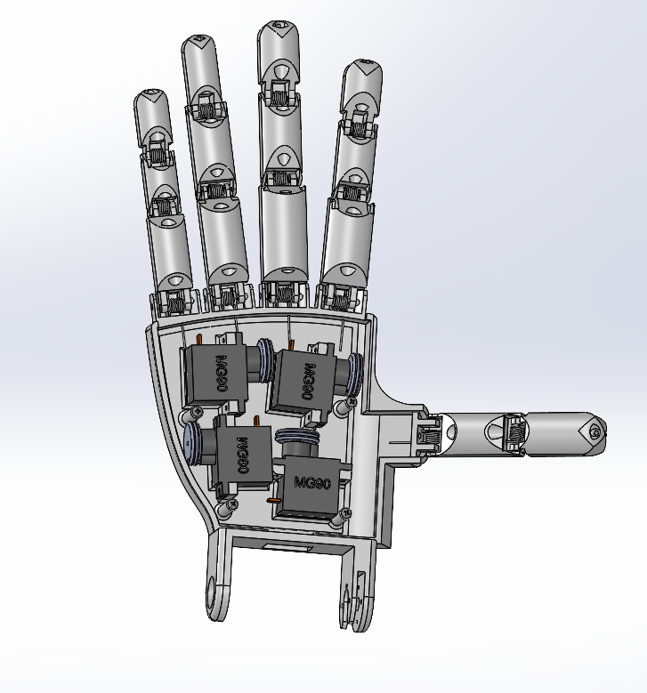
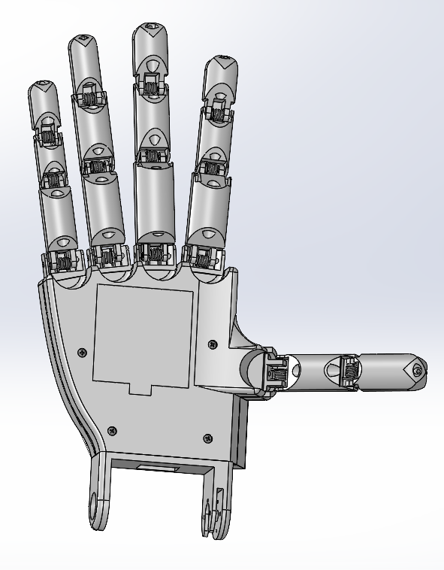
Palm

Slide 27
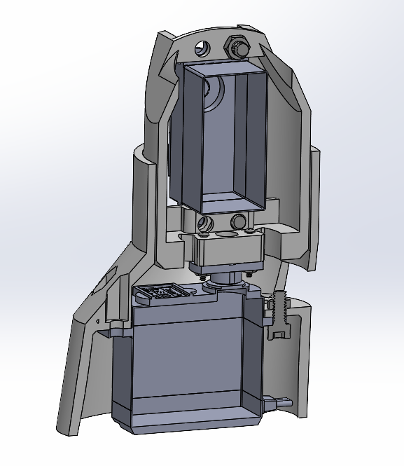
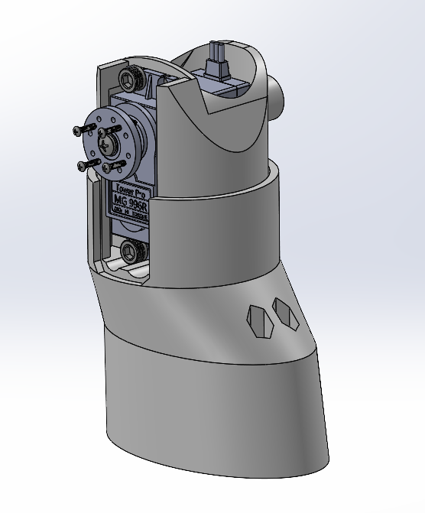
Wrist
Wrist Flexion and Extension
Forearm Rotation
Notes:
V

Slide 28
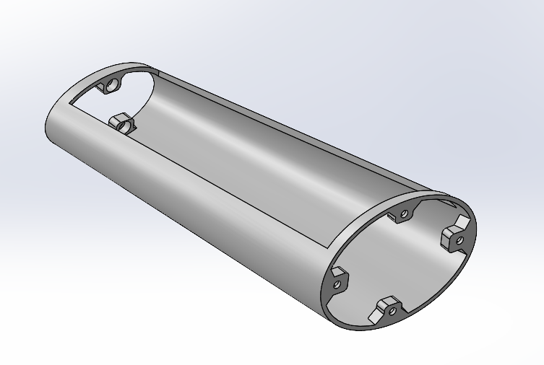
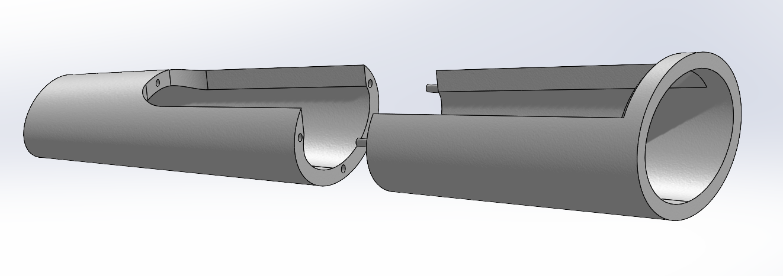
Forearm
First Iteration
Final Design
Notes:
A

Slide 29
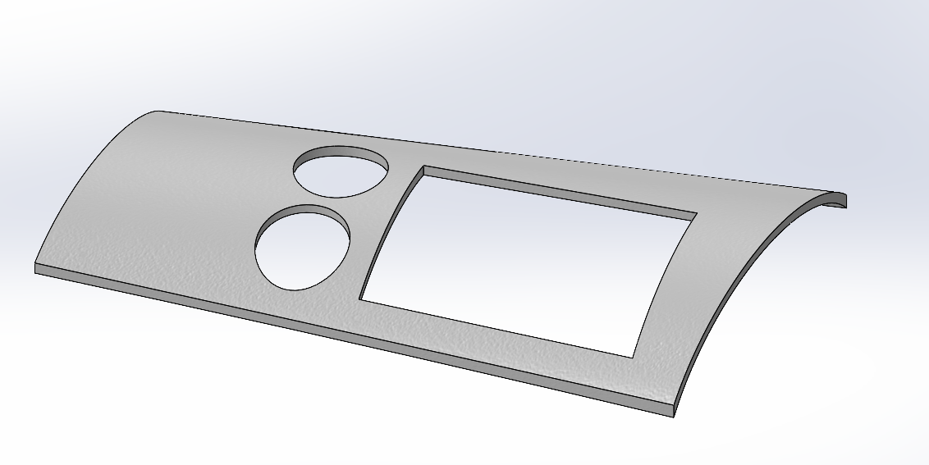
Forearm Cover
Notes:
A

Slide 30
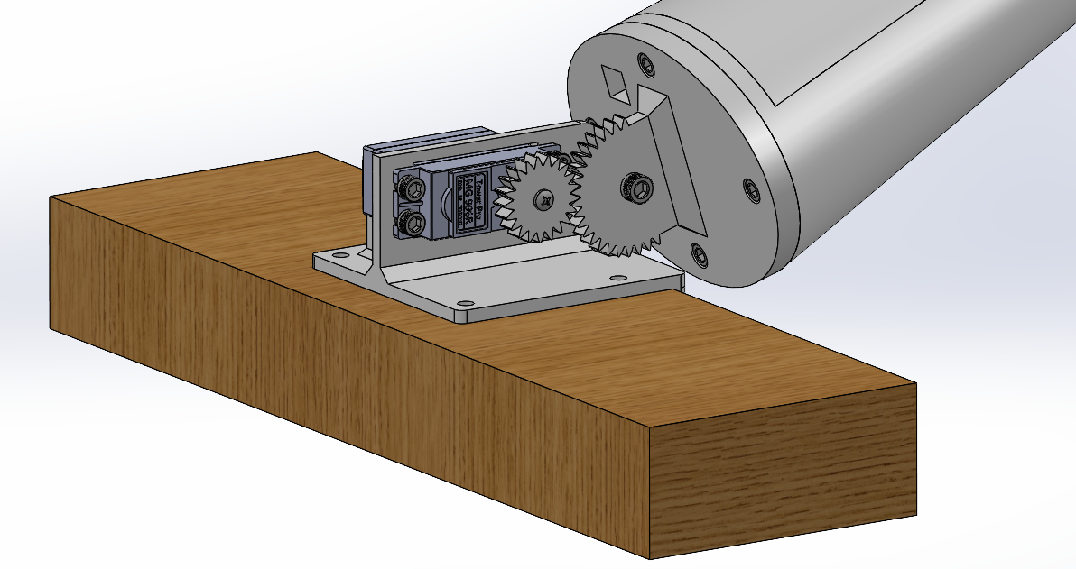
Elbow
1:1.71 Gear Ratio
Notes:
A

Slide 31
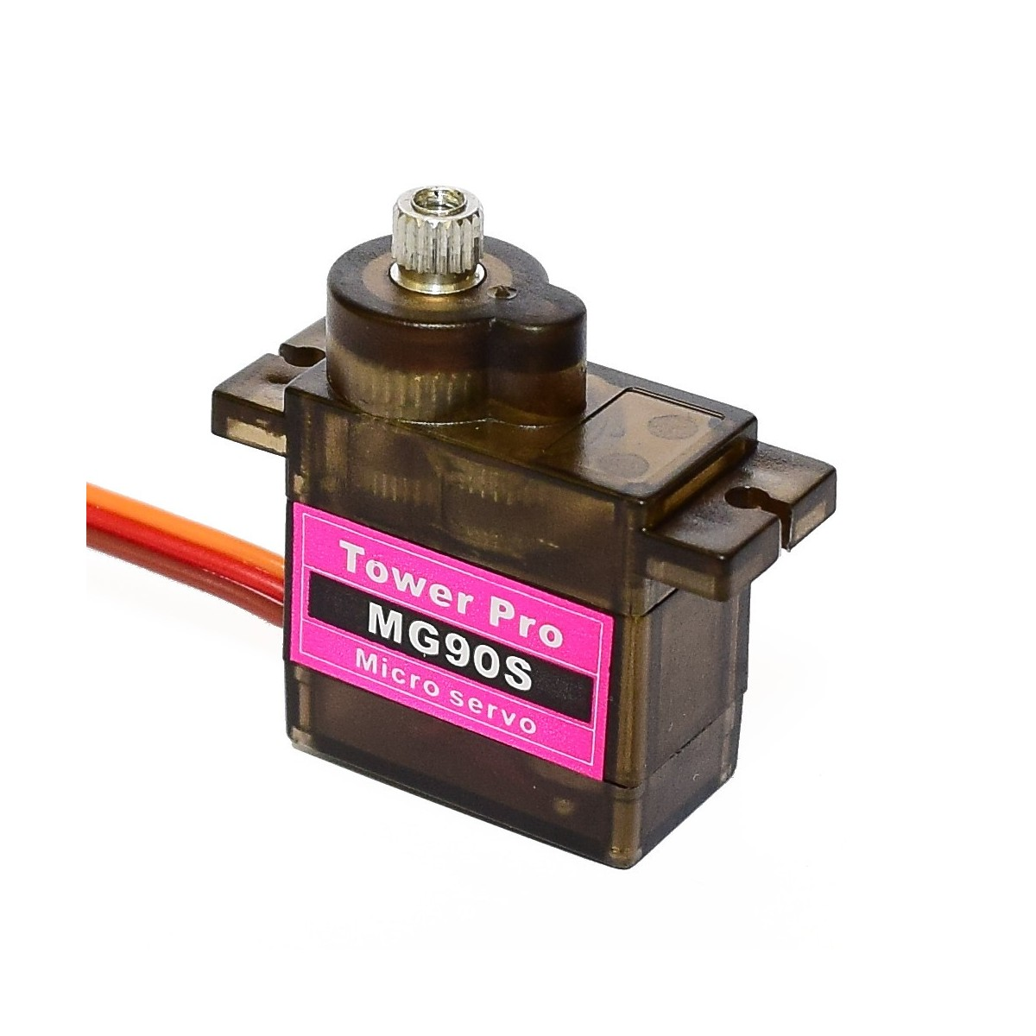
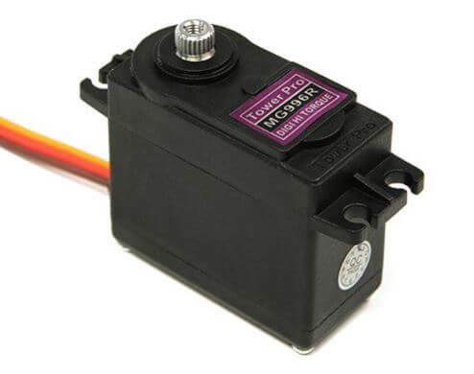
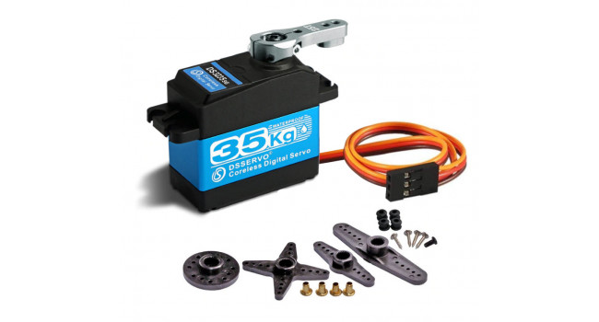
Electronics Selection

Slide 32
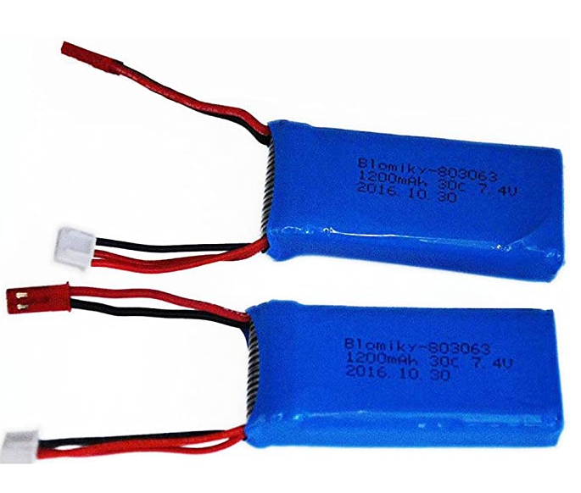
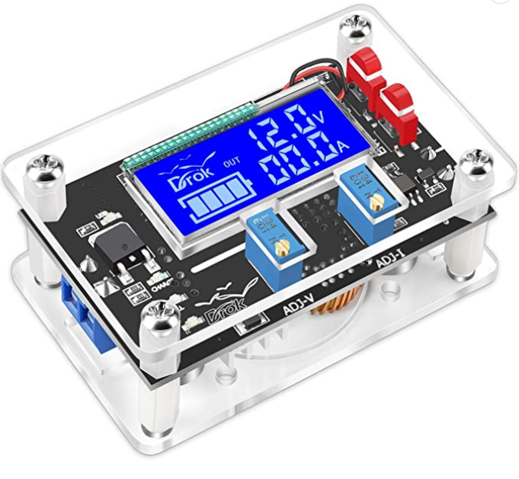
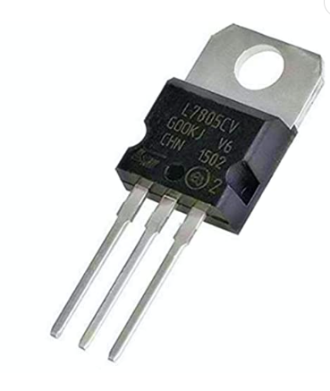
Electronics Selection

Slide 33
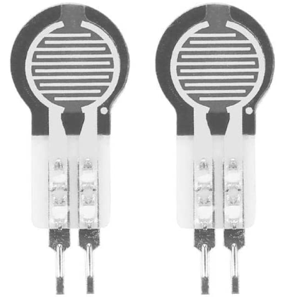
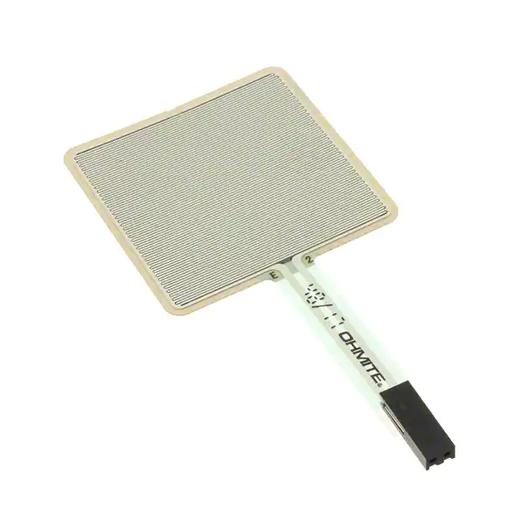
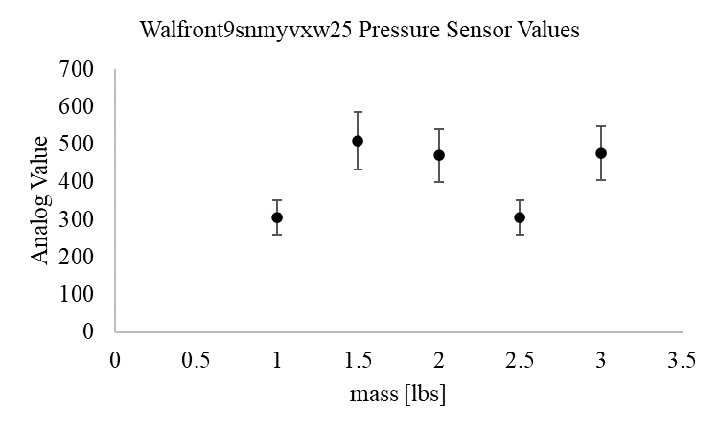
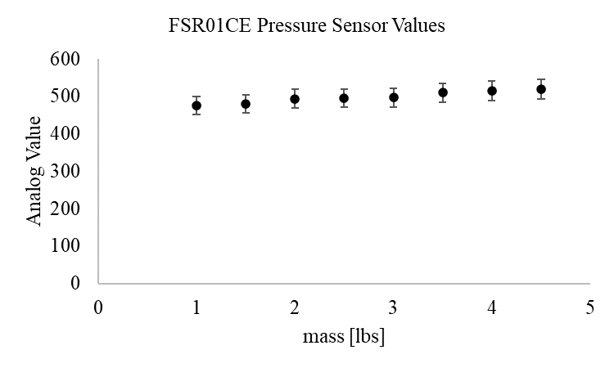
Electronics Selection

Slide 34
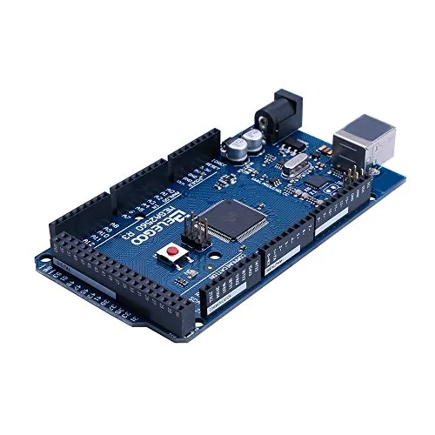

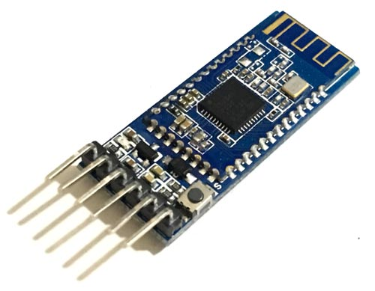
Electronics Selection

Slide 35
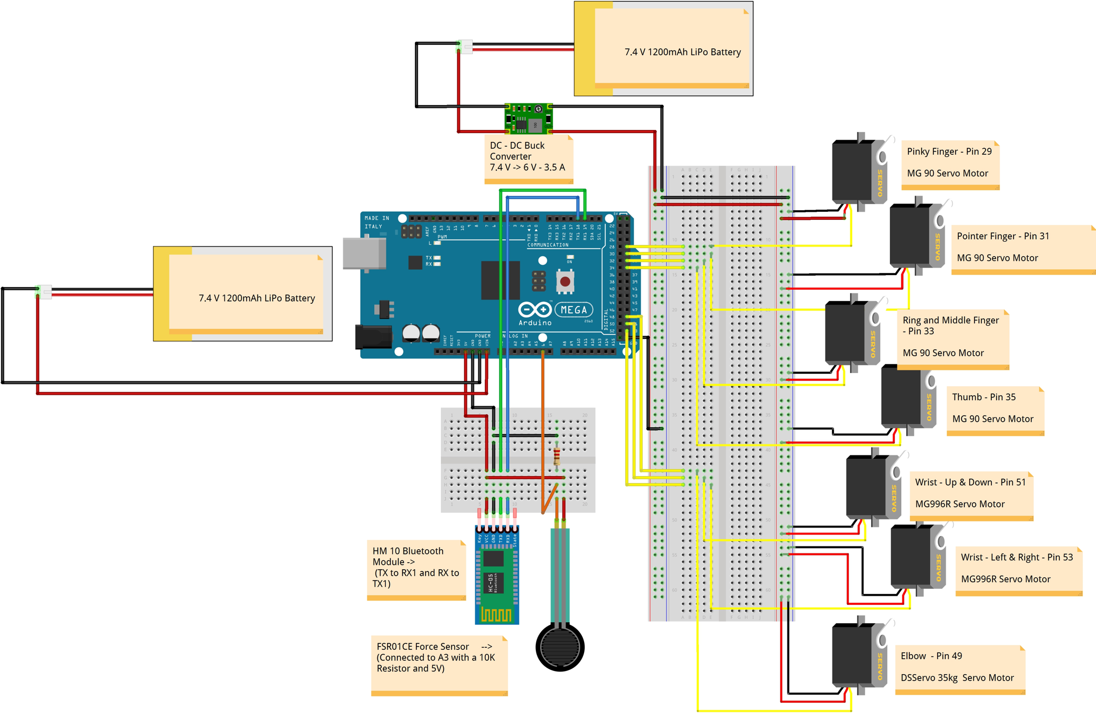
Electronics Wiring

Slide 36
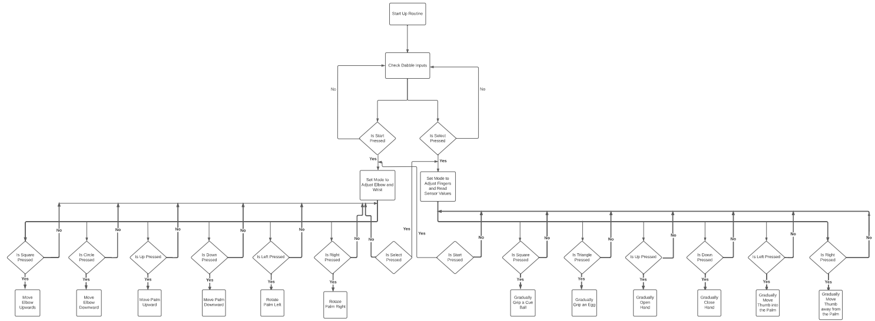

Coding Logic
Notes:
Arduino Mega 2560 Pinout - ElectroSchematics.com
C

Slide 37
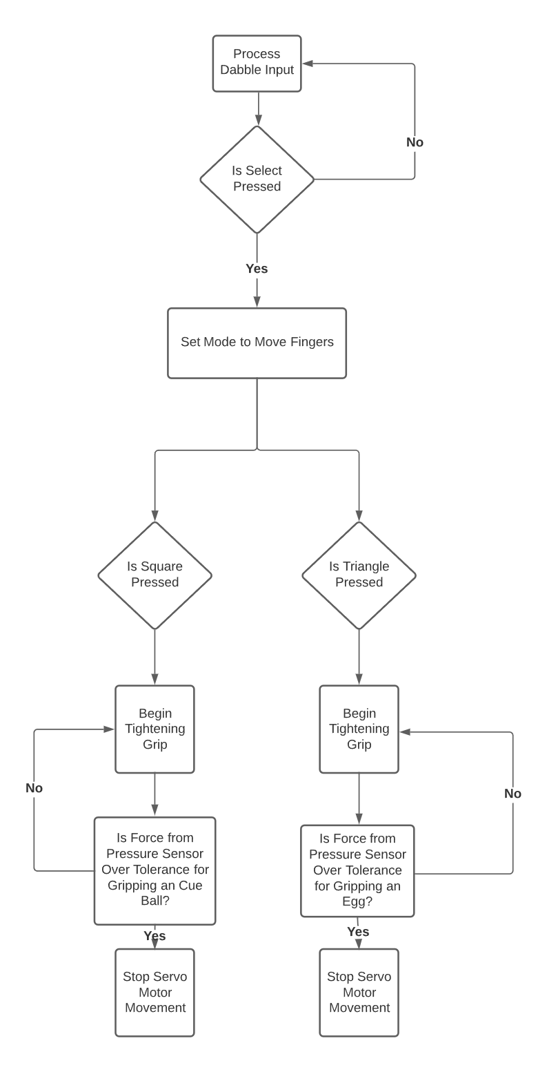
Autonomous Movement

Slide 38
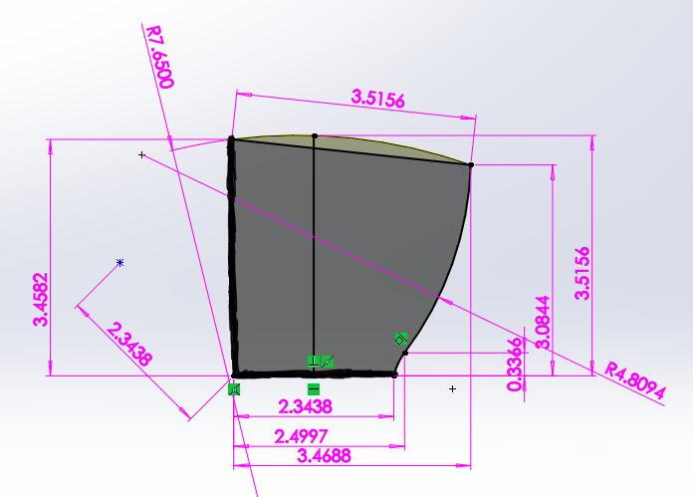
Scalability
 | D1@PB Sketch | D2@PB Sketch | D3@PB Sketch | D5@PB Sketch
Default | 2.5 | 3.75 | 3.75 | 2.5
Fifteen Sixteenths | 2.3 | 3.52 | 3.52 | 2.3
Seven Eighths | 2.2 | 3.28 | 3.28 | 2.2

Slide 39
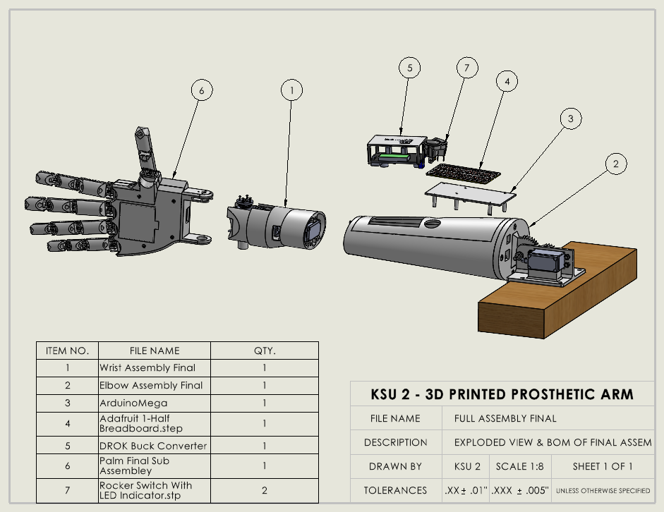
Drawings
Exploded Views

Slide 40
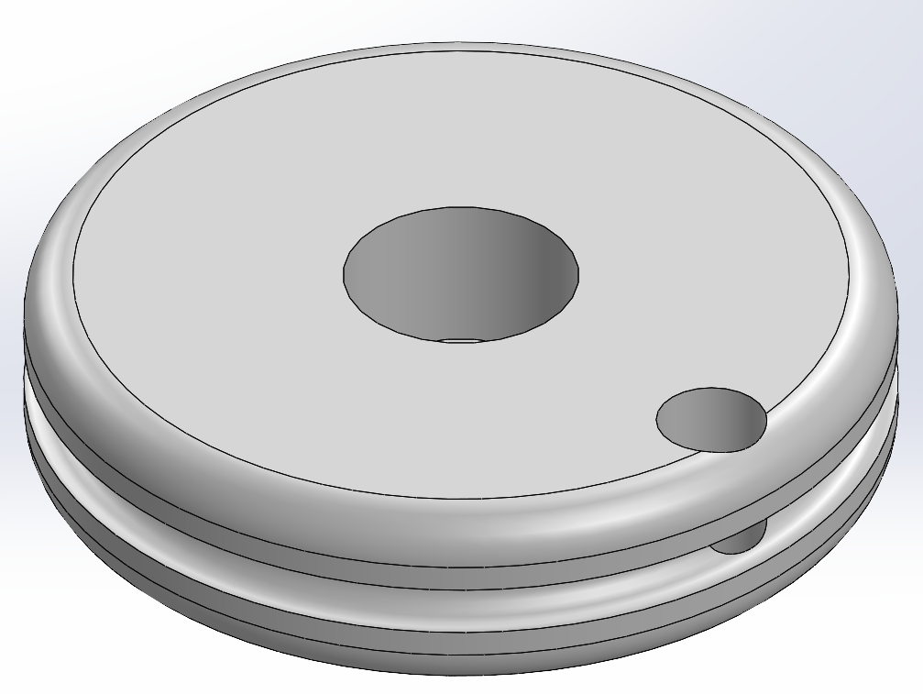
Analysis Overview
Spool Radius Selection
Distance traveled by each finger = 1.10”
180 degrees of rotation from each servo
Found radius of 0.35 inches from circumference calculations
Notes:
We had to find the minimum circumference of the spool and equate that to how much distance the finger tip needed to travel in order to gain a full closing of the hand. MEASUREMENTS AND NUMBERS NEEDED.

Slide 41
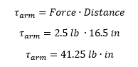
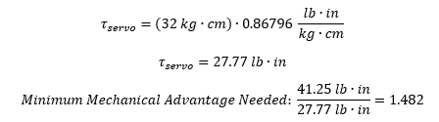
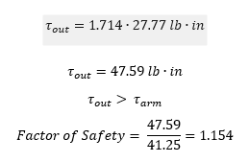
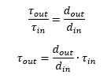
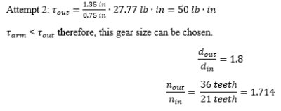
Analysis Overview
Gear Ratio selection:
16.5”
Center of Mass
arm = 2.1 lbs
cue ball = 0.4 lbs
total mass = 2.5 lbs
Servo Axis
Elbow Gear Axis
g

Slide 42
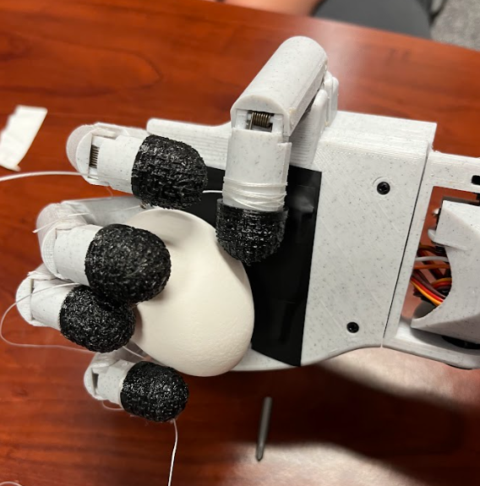
Validation and Verification

Slide 43
Demonstration

Slide 44
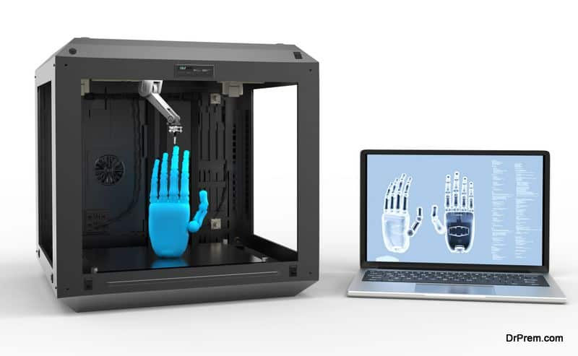
Ethical & Safety Considerations
Accessibility (costs)
3D Printable
Easily Scalable
Safe Design
Components within operating limitations
Components safe within arm and user protected from electrical hazard
Notes:
J & R
https://drprem.com/tech/3d-printed-prosthetics-the-pros-and-cons/

Slide 45

Global, Economic, Environmental, and Societal Considerations
Global accessibility - Open sourcing
Easily accessible file format
Environmental concerns
PETG is readily recyclable
3D Printer accessibility has increased
Low-class families
Accessible through schools and community
Notes:
J
https://www.zenpack.us/blog/decoding-20-common-green-packaging-symbols/

Slide 46
Applicable Standards & Codes
The World Health Organization (WHO) outlines a plethora of guidelines and standards to follow for designing, sellings, and maintaining prosthetics.
The product should:
Be functional,
Not endanger user safety,
Be durable
Have the best possible cosmetic appearance
Be relatively lightweight
Adaptable to the majority of users

Slide 47
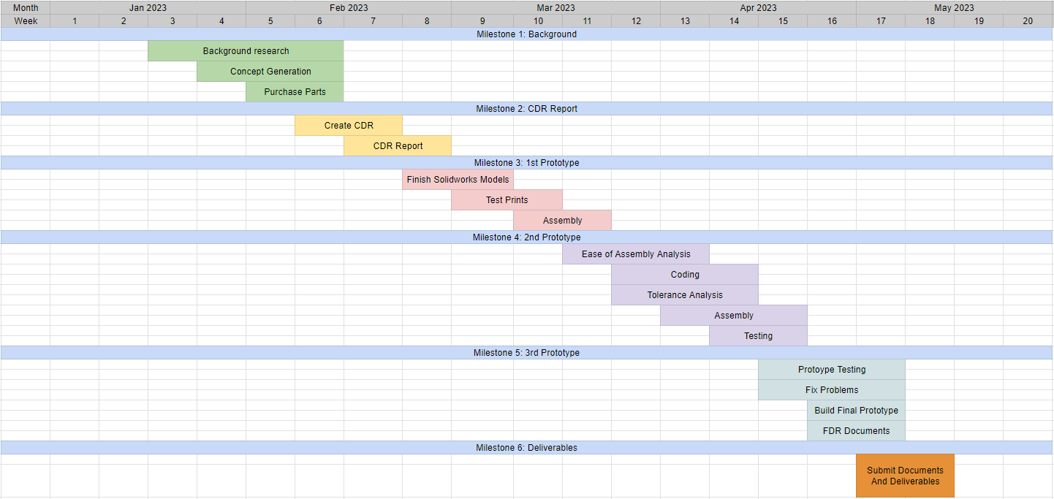
High Level Gantt Chart

Slide 48



Summary of Gantt Chart
Finalize the conceptual design by February 20th
Build the first prototype by March 10th
Build the second prototype by April 21st
Build the third and final prototype by May 8th
First prototype
Second prototype
Third prototype
Notes:
V

Slide 49

Bill of Materials

Slide 50

Bill of Materials

Slide 51
Cost Estimate
Item | Quantity | Cost
1 kg Spool PETG Filament | 1 | $23.99
1 kg Spool TPU Filament | 1 | $30.99
SpiderWire | 1 | $12.88
MG90S 9g Servo (4 pk) | 1 | $14.98
Torsion Spring (6 pk) | 3 | $19.53
Force Sensor | 1 | $11.23
MG996R (4 pk) | 1 | $20.99
DS3235 35 KG Servo | 1 | $29.99
Mount Screws (Various) | 1 | $37.33
Arduino Mega 2560 R3 | 1 | $20.99
Adjustable Buck Converter | 1 | $13.99
7.4V 2000mAh LiPo Battery (2 pk) | 1 | $31.99
Jumper Wires (Various) | 1 | $18.97
HTM 128pc Screwdriver Toolkit | 1 | $24.99
 | Total | $312.84
Notes:
C

Slide 52
Recommendations
Obtain a higher torque servo for the elbow, or utilize pulley system.
Reduce electronics to a custom PCB
Enhance ease of assembly with snap-fits where possible
Improve human-like aesthetics in wrist and palm area (increased contours)
Compatibility with a better controller or input system
Notes:
C

Slide 53
Summary & Conclusions
A complete model of the arm in SolidWorks
Dabble controller that allows the hand to be opened and closed
Hand grips both an egg without crushing it and a cue ball without dropping it
Focus on aesthetics and electronics/wire management moving forward
Notes:
A

Slide 54
Questions?
Notes:
A

Slide 55

Team 2 is #1!
Notes:
R

